Slide 1



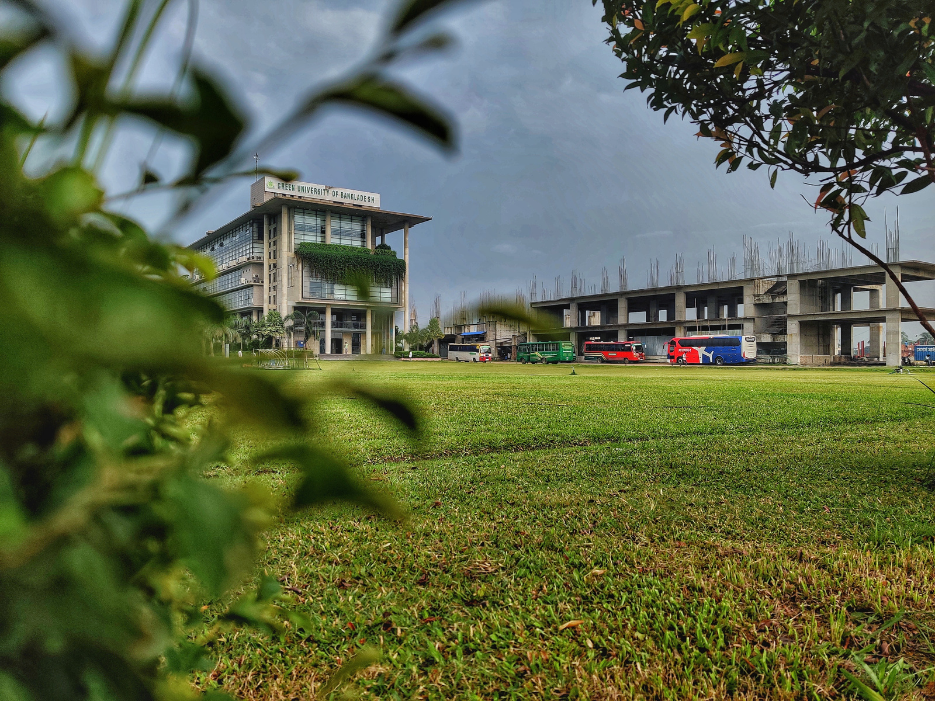


Green University of Bangladesh
Department Of Computer Science and Engineering(CSE)
Course Title: Software Engineering
Course Code: CSE 313 Section: 221 D1
Presented to
Professor DR. MD. Ahsan Habib
Professor, Dept. of CSE
Green University Of Bangladesh
1

Slide 2


Md. Mahim Hossain
221902082
2

Slide 3





Welcome To Our Presentation
PROGRAMMING HERO
3

Slide 4

PROGRAMMING HERO
BRIEF OF COMPANY
We focus on teaching programming and then helping our successful students to land a job/internship.
Address:
Level-4, 34, Awal Centre, Banani, Dhaka
Email: jhankar@programming-hero.com
Phone: +880 1322 810 863
Web: www.programming-hero.com
CEO
Founder,
4

Slide 5

PROGRAMMING HERO
VISION & MISSION
Vision
To be a global leader in programming education, offering interactive and engaging learning experiences.
Mission
To make programming education fun and accessible for everyone, empowering individuals with the skills to excel in the tech industry.
5

Slide 6




PROGRAMMING HERO
SERVICE PROVIDE
Web
Development
Course
Neptune
Job
Placements
Programming Hero Mobile Application
6

Slide 7


PROGRAMMING HERO
GROWTH
7

Slide 8
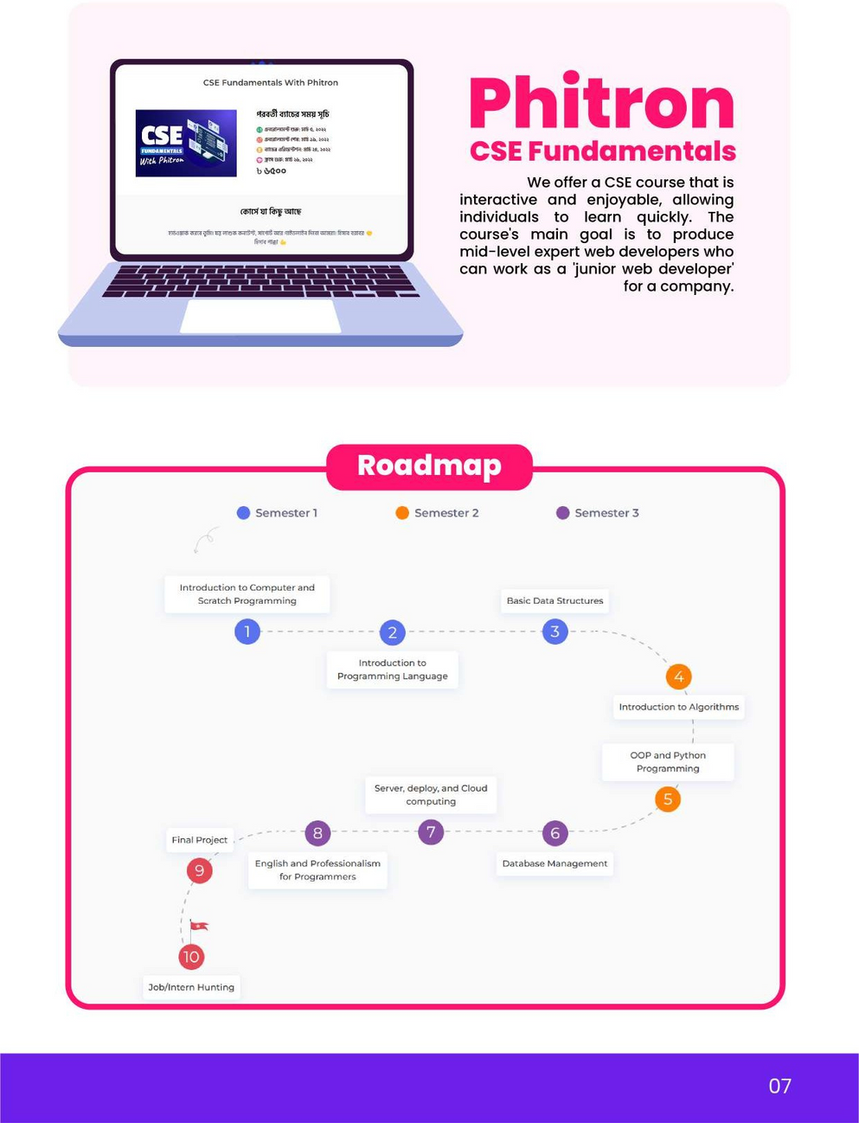
PROGRAMMING HERO
PHITRON
Semester 01
Semester 02
Semester 03
8

Slide 9

PROGRAMMING HERO
THANK YOU
Thanks everyone for being here – your presence means a lot!
9

